Slide 1



Lista Streamów
Accenture.

Slide 2
Lista Streamów
EY.

Slide 3


Course Description
ServiceNow was founded in 2004, is based in Santa Clara and is ranked #1 on the FORTUNE Future 50 list of world companies with the best long-term growth potential. ServiceNow delivers digital platform allowing all organization departments to develop, run and manage their processes across whole organization with a single cloud model.
ServiceNow Fundamentals is the starting point for everyone to begin their ServiceNow journey. Either if they wish to get familiar with the platform, become a experienced administrator, platform developer or future architect. This course is an real time configuration simulation and self-paced based training, overviewed by Platform experts.
Entrance Exam
Basic of database concepts and general IT knowledge.
Business processes automation by EY -ServiceNow Fundamentals
Additional Qualifications
English at level allowing to get familiar with technical documentation
Stream
Owners
Topics
Mateusz Kontowicz
ServiceNow overview, available modules, use cases
User Interface, filters, lists, forms
Task Management, notifications, reporting, knowledge management
Service Portal and Service Catalog overview,
Process designer ( Flow Designer),
Summary and development opportunities
Course volume
23 hours total
Self-paced
Sync meetings with trainers
Language
English

Slide 4
Course Description
Entrance Exam
This course is designed for IT, industrial automation and cybersecurity student who wants to extend their knowledge on the cyber security aspects of the OT and IoT environments, with particular focus on protection of critical infrastructure.
The aim of the course is provide an understanding of cyber threats to the modern digital environment involved in industrial control and monitoring, and those utilizing internet of things technologies. The course will also provide an overview on methods and strategies to protect against such threats.
Basic knowledge of IT networks
OT/IoT Cybersecurity & Critical Infrastructure Protection​
Additional Qualifications
Command of English B1/B2
Topics
Stream
Owners
Principles of OT and IoT security
Case studies of cyber attacks on OT and IoT
Evolution of Internet of Things and security consequences
Leading OT and IoT security standards
Showcase of typical attack technics
Typical security measures utilized in OT and IoT
Typical processes of OT security operations
Leszek Mróz
Course volume
7 hours
weekly meeting 60 mins
Language
English

Slide 5
Lista Streamów
ING Tech Poland.

Slide 6
Entrance Exam
Course Description
Good English skills
Short entry task on why would you like to participate
Communication and conversation are the foundations of society. In business environment however, communication takes on a myriad of additional meanings – how we write, speak, share information, all these things reflect on how we are perceived by our employers, superiors and peers. In the digital world we are even more visible, so we naturally want to be noticed from the very best perspective. Let’s talk about all the tools of communication, the physical, methodological and language ones. See what tools we know and how to best put them to use. Let’s see how important cultural differences in our company are, how they influence our communication and check how can a given set of tools make communication easier despite said differences.
Communication and Multiculturalism in Business
Additional Qualifications
none
Topics
Stream
Owners
Recognition and Transaction Analysis in Business Communication
Public speeches
Corporate Social Responsibility
How to build relations
MS Teams workshops - communication overcoming distance
Communicating with the employer - CV and interview
Online communication - verbal, non-verbal, dos and don’ts
Project management, agile, scrum
Daria Kaczor, Sabina Czarnecka, Kaja Kalmus, Izabela Kucharska, Fabian Cygert, Radosław Dudek
Course volume
12 hours
weekly meetings 1-2 h
Language
English

Slide 7
Lista Streamów
Kyndryl.

Slide 8
Entrance Exam
Course Description
This course is dedicated for students who would like to broaden their knowledge and understanding of Project Management Office. We will show you where PMO is located in a Project Management concept, what are the differences and dependencies. During the course we would like to present ongoing processes PMO is handling during the lifecycle of the project starts and describe it step by step – preferably with real life examples. The learning program is focusing on improving your awareness about project management and processes; skills as: analytical thinking, problem-solving and attention to details. Students will also get familiar with different methodologies of handling projects.
Fluent English in speech and writing
Administration in Project Management - PMO
Course volume
10 hours
weekly meeting 1-2 h
Stream
Owners
Topics
Introduction to project management and PMO.
Governance, access and operational activities.
Finance management.
Introduction to reporting and risks & issues management.
Change management and program deliverables (scope).
Other key parallel processes (project planning, resource management and procurement).
Closure management and summary.
Katarzyna Żurawska
Language
English

Slide 9
Entrance Exam
Course Description
English language at least on B1 level
The course will cover the essentials of customer care, basic IT technical skills, knowledge used in Service Desk environment and client management. The basics will be covered based on best practices and experience developed in one of the leading companies from IT sector and commonly used to support business customers. There will be multiple workshops with practical exercises using different methodologies, among others design thinking.
Client Management in IT environment
Additional Qualifications
Basic IT
Topics
Stream
Owner
Call handling and difficult client management
Quality in customer care
Business email handling and chat netiquette
IT troubleshooting
Networking basics
Cyber security
Rachel Formella
Course volume
31 hours
weekly meeting 3.5 h
Language
English

Slide 10
Course Description
Entrance Exam
The purpose of the course is to provide students with basic understanding of IT Architecture as a profession, design and architectural thinking principles, different domains within architecture, learn architecture practice, train design skills, understand architecture frameworks and help them to develop a vision of technologies and architecture patterns.
Basic knowledge of of project management, service management, computer technology (cloud, datacenter..)
IT Architecture
Additional Qualifications
Topics
Introduction to Architecture
Introduction to Projects
Architecture standards
High-Level and Low-Level Design
Assets & Artefact
Business Analysis
Architecture Components and Models
Analytical thinking
B2 English in speech and writing
Stream
Owners
Course volume
Krzysztof Lebiedziński
Oleksandr Chuchko
12 classes – 3h with coffe break
9 labolatory – 2h with coffee break
10 OpenHours – 1h free discussion
Language
English

Slide 11
Entrance Exam
Course Description
Basic knowledge of IT
Mainframe
This course is designed for IT students who wants to get knowledge about the rarest and most prestigious IT servers.
The aim of the course is to prepare the students for possible job (Mainframe Operator).
Additional Qualifications
Topics
Command of English B1/B2
Why Mainframe?
Use of Mainframe technology
Differences between PC and Mainframe architecture
JCL as a Mainframe scripting language
How does the Mainframe Operator job look like?
Stream
Owner
Bartłomiej Dul
Course volume
8 hours
meeting 120 mins
Language
English

Slide 12
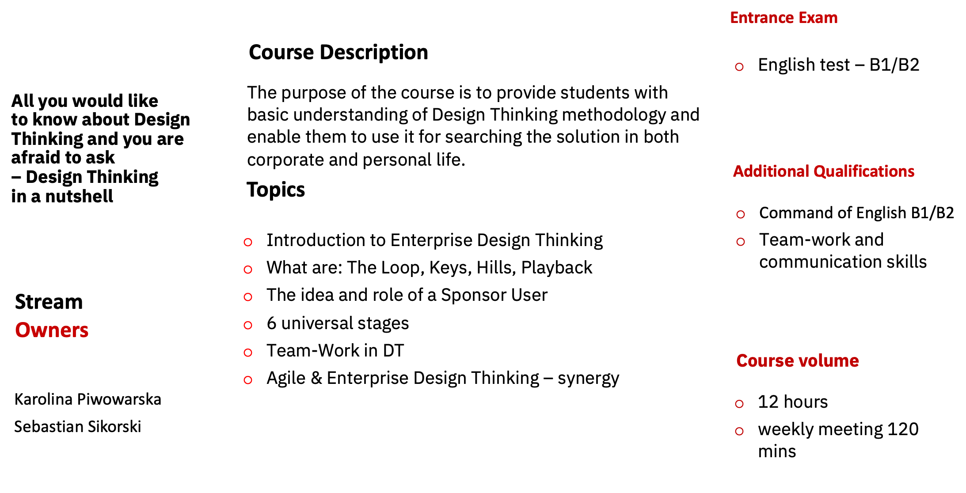
Language
English

Slide 13
Course Description
The purpose of this course is to show you, what Hybrid Management Tools are, what are they used for, how you can use basic knowledge of operating systems (Linux) and programming languages to manage the service of various applications for recipients from many different sectors.
Goal of Procedural module focus on the Service Management functioning within big IT Structures. It’s exceptional chance for a glimpse into core of the Service. Technical part will take you a step deeper into Hybrid Management Tools overview on particular examples.
Entrance Exam
Linux basics
SQL basics
ITIL basics
Hybrid Management Tools
Additional Qualifications
Workstation with web access
Topics
I Procedural
Stream
Owner
Introduction to Hybrid Management Tools
Leading IT Services
Non-technical person in IT world
II Technical
Monitoring & Event Management
Introduction to Server Resource Management
BlueCARE and M&EaaS
Agnieszka Krakowiak-Cichoń
Course volume
13 hours
1 h/week
Language
English

Slide 14
Entrance Exam
Course Description
Basic JavaScript Knowledge
Basic ITIL Knowledge
Entry Test
Completed Learning on NowLearning (free):
Get Started with the Now Platform Simulator
This course will teach you everything about ServiceNow so you will be able to start your journey with that fabulous tool. We will cover the whole path to understand what ServiceNow is, how to administrate and how to write scripts. This course is an entry guide for those who would like to begin a career as a ServiceNow Consultant.
ServiceNow journey by Kyndryl
Topics
Stream
Owner
ServiceNow Introduction
ServiceNow Administrator 101
Become a ServiceNow Developer Part 1
Become a ServiceNow Developer Part 2
The power of ServiceNow to ServiceNow integration
Create a ServiceNow Scoped Application
Kamil Kowalczyk
Course volume
6 x 1.5 hours
weekly meeting 1.5 h
Language
English

Slide 15
Course Description
Entrance Exam
The course will cover the essentials of Service Management. The program is aligned to ITIL’s best practices and based on standards developed by IBM Service Management. The lectures will be covered with accordance to Agile methodology commonly used in Kyndryl.
The aim of the course is to train on various skill sets necessary for deciding whether a student would like to work for Kyndryl and which sector to choose.
Basic knowledge of English
IT Service
Management
Additional Qualifications
General knowledge about Project Management Methodology
Analytical thinking
Topics
ITIL Introduction
Agile Methodology
Incident Management
Change Management
Problem Management
Quality in IT processes
Corporate work culture in a multinational company
Service Delivery Account Management Overview and Careers at Kyndryl
Stream
Owners
Łukasz Rudnicki
Course volume
18 hours
weekly meeting 60 /120 mins
Language
English

Slide 16
Entrance Exam
Course Description
This course is designed for anyone interested in project management.
The aim of the course is to understand and apply project management in work or life related projects.
Advanced knowledge of English and general understanding of project management
Project Management
the Kyndryl Way
Additional Qualifications
Topics
Command of English B1/B2
Project definitione and planning. Specifities of IT projects
Agile and Agile Values in project management
Communication and collaboration tools
Risk management
Change management
Stakeholders manaement
Monitoring and control
Quality control, project execution and closing
Stream
Owners
Katarzyna Geisler-Ciurlej
Emil Rosiński
Course volume
25 hours
weekly meeting 240 mins
Language
English

Slide 17
Opis kursu
Egzamin wstępny
Kurs jest przeznaczony dla osób zainteresowanych tematyką IT oraz rozwiązaniami stosowanymi w chmurze. W trakcie zajęć oraz warsztatów na platformie IBM Cloud przedstawione zostaną podstawowe pojęcia oraz narzędzia związane z rozwiązaniami typu Cloud. Warsztaty pokażą zastosowanie narzędzi takich jak Ansible, Docker, Openshift oraz metodyk Agile i DevOps.
Sprawdzenie wiedzy na temat systemów operacyjnych Linux – poziom podstawowy
Cloud Development & Operations
Tematy
Wymogi na zaliczenie kursu
Wprowadzenie do Clouda i GitHuba
Konteneryzacja z wykorzystaniem Dockera
Zarządzanie kontenerami przy użyciu Red Hat Openshift
Postman – REST API dla początkujących
Automation with Ansible
Wprowadzenie do Agile
Aktywne uczestnictwo we wszystkich zajęciach (100% frekwencja na zajęciach)
Stream
Owner
Rafał Skóbel
Długość kursu
Language
English
6 zajęć, każde trwające 1,5-2h

